Slide 1

Summary – Grid for Financial Services
(specific discussion Hartford Financial services)
Enterprise/Corporate/Academic – Financial services (Hartford 30,000 employees)
Domain: Financial positions, trading
Requirement types: compute grids, data grids, memory grids, process grids, cycle scavenging
Number of machines: tending to over 10,000 (capacity grown to above 8000 ;looking to expand to 25000)
Model: multiple administrative domains migrate to single admin domain or federated, geographically dispersed, local centers (as opposed to pure remote access), multiple applications, heterogeneous platforms (OS) (federated model for architecture, local pools with technology agnostic interfaces that are integrated with meta-schedule; single OS image)
Challenges/Constraints: Caching of information is critical as decision get more real-time (e.g. keeping indexes in memory to achieve competitive advantage)); ideally would like to keep most data in near “memory”; increase utilization of capital investments; security, standards maturity, organization politics, Business issues (charge back), expectations management (be realistic on what Grids can deliver; manage the hype) (funding is not an issue but need to curtail spending so that current capital will be used effectively)
Technology solution: Globus, (Condor – scalable, flexible, mature and free; commercial vendor (?)), active directory, oracle databases
Organization layout: Capacity determined by a minimum and grow as avallable (use policy structure in technology to enforce)
Motivation: Reduce time to decision and minimize risk in decisions; real time calculation is a competitive advantage (higher profits; discover market opportunities; consolidating resources (scale computations), scalability, mitigate management overhead (hedging (modeling of exposure to variable annuities,, Stochastic modeling *monte carlo simulation) for annuities (e.g. mortality etc), convergence, current solution did not scale to handle number of workers that can simultaneous use and was difficult to use)
Future Plans: .Grow the grid to incorporate desktops and reduce capital expenditure; create a shared file system to use local disk space.
Financial Implication: Time to market and manage financial risk, reduce/defer capital costs, free up risk reserve.
User types: Traders, modelers. actuators
Motivators: Organization policy, demonstrated benefits
Capabilities: Policies (fair use), Accounting, reporting, security, federation, automation (process)
Applications: Master – worker model (centralized creating and workers are distributed and can be put on the grid); compute intensive and data light, parallelizable and partition able; task oriented, non-computational only (create reports on projections that will help manage the risks; modify the applications to run on the grid; mainly in-house developed applications; market scenarios generated on the fly in memory and so minimal data transfer)
Problems: Around the management of the grid and get it operational and self-sustaining as a solution; how to maintain very high levels of uptime
Needs: Grid architecture for resiliency, interoperability, simple to use – good user experience and transarency, management standards, reliable and secure infrastructure (SOX etc), chargeback models, transition/evolution models, capacity on demand

Slide 2
OGF20 AutoAero Background Workshop
Background for the Auto and Aerospace Workshop on May 9 at the Open Grid Forum conference in Manchester
Auto and aerospace firms have taken different approaches to using Grids. To make a major generalization, the focus for automakers has been data Grids while for aerospace firms the emphasis has been on compute Grids. Both groups have been pioneers in developing collaboration initiatives.
The main aims in using Grids for auto firms appear to be the goals of the SIMDAT project:
  Develop federated versions of problem-solving environments
  Support of distributed product and process development
  Test and enhance Grid technology for access to distributed databases
  Tools for semantic transformation between these databases–
  Grid support for knowledge discovery
  Promoting defacto standards
  Raise awareness in important industrial sectors

Slide 3
OGF20 AutoAero Background Workshop
In particular, the auto firms working with SIMDAT have identified a few key challenges:
  Creating better problem solving environments with data applications architecture fully integrated Server based problem solving.
  Integrating different disciplines (CAD, CAE, and CAT) as well as different locations and organizations.
  After bringing together integrated knowledge services tools and comparison reporting, where are the next steps?
  How can auto firms capture the results of thousands of existing simulation processes, parameterize them and identify critical changes that need to be communicated to other groups running simulations?
  What is needed to improve workflow integration beyond its current state?
  How can the collaboration environment created with Web services be improved? SIMDAT has already achieved multi-disciplinary inter-enterprise collaborative design in several projects, but not widespread use of collaboration environments.

Slide 4
OGF20 AutoAero Background Workshop
VIVACE has focused on creating a secure, collaboration hub to facilitate exchange of designs between firms participating in the project. Some issues include:
  What will be the results of the VIVACE collaborations and how will they be implemented?
  Will there be any issues concerning how Grids support transactional and analytic capabilities required for aerospace collaboration?
  How will large numbers of simulations be managed and what intelligence will be added to simulation systems?
  Will VIVACE and SIMDAT move to common collaborative frameworks?
The workshop will provide an opportunity to address these issues and to meet with experts who are thinking about them and working on innovative solutions.
If these issues are of concern to you, please attend the workshop.
Other programs in the Grid Means Business sessions on May 8 and 9 and in the Open Grid Forum meeting will also address these issues. Please see www.ogf.org.
We expect to have extensive participation by SIMDAT and VIVACE in the workshop.

Slide 5
OGF20 Workshop AutoAero use of grids
Title: Workshop on Auto and Aerospace Firms’ Use of Grids: Enterprise Requirements
Summary:
This workshop will examine issues that auto and aerospace firms need to address when they operate clusters and Grids. The workshop provides a chance for these firms to understand and discuss these issues in a forum that includes experts on Grids and cluster computing, data management, and storage.
We hope that the discussion identifies a series of best practices at auto and aerospace firms. We expect that these best practices will contribute to a more detailed discussion of the priorities that the Open Grid Forum should take in its work on standards for Grid computing.
The workshop will begin with several short presentations on generic issues of interest to the auto and aerospace firms. These presentations will be followed by a roundtable discussion of the key issues that participants want to explore in greater detail. We will provide a more detailed agenda prior to the workshop.

Slide 6
OGF20 Workshop AutoAero use of grids
Takeaways:
  1) A better understanding of the issues facing Grid users in autos and aerospace.
  2) An opportunity to meet and discuss issues with some of the main experts in the Grid community.
  3) An identification of where the “problem points” for auto and aerospace firms exist in the current use of Grids.
  4) An opportunity to get some idea of when and how these problem points will be addressed
  5) An opportunity to obtain useful information about where Grid technology is moving
  6) A chance to see what best practices characterize some of the more interesting Grid adopters.

Slide 7
Issues for EDA
Data-tagging, including managing files
Scheduler - a meta scheduler for virtual dependency management
Profiling of data
Dynamic Provisioning
Standard mechanism from the API that could extract out information about a project or a product.

Slide 8
Pharma Issues
Jobs submission
Job control management, including error management clearly identifying job errors. Standards for pushing compute jobs around.
Need for a middle tier layer that lets users grab the right data -- categorizing data
Simplify application development by creating better APIs

Slide 9
Semiconductor Issues
Load balance license servers. Want flow control to get optimal control of license. Want to load balance the license servers that are deployed.
Monitoring of the compute farms that is dynamic and tunable or customizable
Charge back and metering, particularly when multiple projects share the same infrastructure.

Slide 10
Semiconductor Issues 2
Validation. Make sure there is a fine grain validation of access to resources; associate attributes with Grid identity. Also, require a validation/security mechanism that handles things consistently across flows.
Need storage aware scheduling. Must have hooks in place. The direct structures and disk volumes become full, so then flow control comes into play.

Slide 11
Semiconductor 3
OGF storage standard – need to define attributes about storage system that we schedule a job into. Dynamically updated information about storage.

Slide 12
Pharma Issues
More advanced metadata semantics are needed as part of Grid infrastructure. This would need to have ontology and terminology management.
Problem getting software to run on Grids at pharmas.
Not all PCs can talk to the license servers.
Need to talk to several different scheduling systems for jobs.

Slide 13
Pharma Issues 2
Need to have common data repository with UML level. Common ontology. What could be standardized is some type of shared representation of what a data repository should look like.
Sharing resources across organizations is an issue. This raises issues of whether can provide a license or not. If pharmas had a tokenization capability, they would not have to worry about running on other systems.

Slide 14
OGF18 - What We Heard
Our Visions are Consistent
  Agile
  Adaptable
  Transparent
  Responsive
  Flexible
  Fault Tolerant
  …
Wide Range of Requirements
  Cluster, Data Center, and Collaboration Grids
  Simple & Concrete through Complex & Abstract

Slide 15
High Value Use Cases
Grid APIs
Job Submit
File Movement
Application Provisioning
Data Provisioning and Data Grids
Grid Security

Slide 16
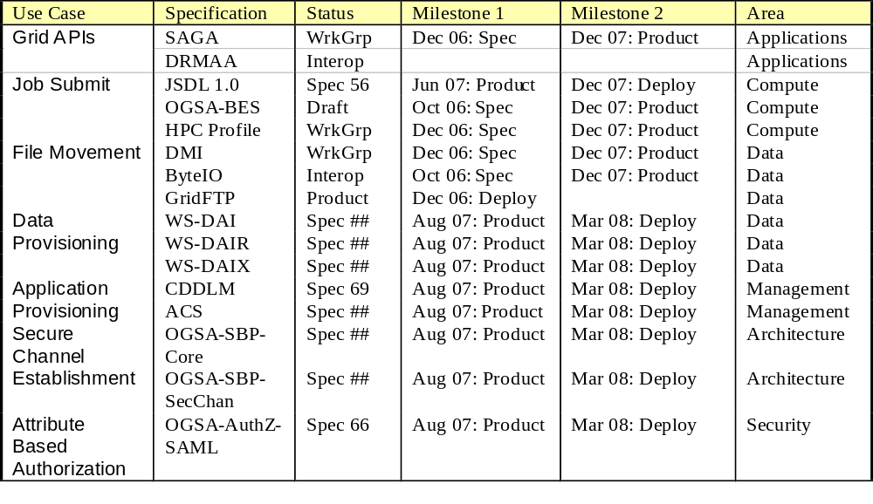
Roadmap Snapshot

Slide 17
EGA Data WG requirements
DETAIL! DRILLDOWN!
  Asset Discovery, Asset
  Management and Topology
  Provisioning and Capacity Management
  Root Cause Analysis
  Data Copy, Data Movement and Backup
  Policy Management and Quotas
  Monitoring, Auditing and Alert Management
  Content provisioning and Discovery
  Billing and Chargeback
Device
Management
Data
Management

Slide 18
Prioritization
Communicate High
New SG Medium
New EG Low
New Process
Promotion
Out of Scope
Requirement | Action | Priority
Workflow Planning/Auth. | Promotion - Letter (Tool request) | Med
Autonomic |  | Low
Distributed Execution |  | High
Verification & Audit |  | High
Resiliency |  | Low
Interoperable Standards |  | High
Job Submission |  | High

Slide 19
Prioritization
Communicate High
New SG Medium
New EG Low
New Process
Promotion
Out of Scope
Requirement | Action | Priority
Job Management |  | High
Graphical Management Console (EOU) |  | Low
Strong Security |  | High
SOX Support |  | Low
Chargeback Models
Seamless Migration
Dynamic Provisioning

Slide 20
Prioritization
Communicate High
New SG Medium
New EG Low
New Process
Promotion
Out of Scope
Requirement | Action | Priority
Data Tagging
Data Aware Scheduler
Data Profiling
API for Product Capability Discovery
Job Migration Standard
Error Management Standards

Slide 21
Prioritization
Communicate High
New SG Medium
New EG Low
New Process
Promotion
Out of Scope
Requirement | Action | Priority
Catalogue Based Data Access
Data Grid APIs
Deep Error Analysis
Detailed Asset Discovery
Replica Management
Content Provisioning

Slide 22
Prioritization
Communicate High
New SG Medium
New EG Low
New Process
Promotion
Out of Scope
Requirement | Action | Priority
Storage Policy Management
Error Audit
Scale (10000+ nodes)
Multiple Domains
Heterogeneous Platforms
Management Standards

Slide 23
Initial List of Best Practice Areas
#2
Application Suitability for Grid
Application Porting to Grid
Grid in Financial Services
Increasing Infrastructure Utilization
Grid Deployment and Management
Grid Financial Justification
Grid Service Level Management
Vendor Selection Process
What type of Grid to use ?
License Optimization and Management
Use of External Grids integrated with Enterprise
Data Management and Integration, Security, Clean Up
Integration of Grid Security with Enterprise Environment
#1
#3

